Slide 1
Problem statement and solution
For TwoThousandChatbot project
-Tonny Chen

Slide 2

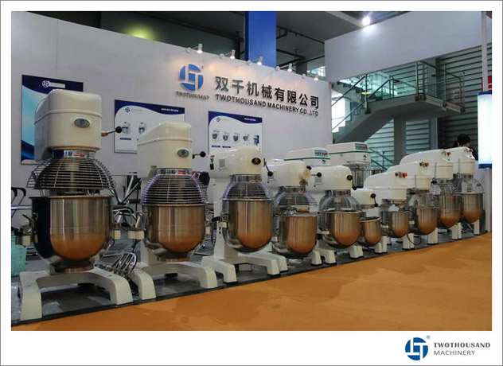
Problem statement
TWOTHOUSAND® (https://www.twothousand.com/)is a kitchen equipment manufacturer and exporter based in Guangzhou, China. One of the main channels for TWOTHOUSAND to expand its market is through Alibaba, an e-commerce platform. TWOTHOUSAND® wants to attract local distributors, who tend to order a large amount and become frequent customers. The issue is that Alibaba has quick-response rating criteria that require businesses to respond to a certain number of queries in a certain amount of time. Alibaba downgrades companies that fail to achieve this criteria. TWOTHOUSAND® notices that some queries are unprofessional and likely from retail customers, who are less critical than local distributors. However, staff need to reply to these queries to maintain the rating on Alibaba.
Image reference:
https://www.twothousand.com/about-us/

Slide 3
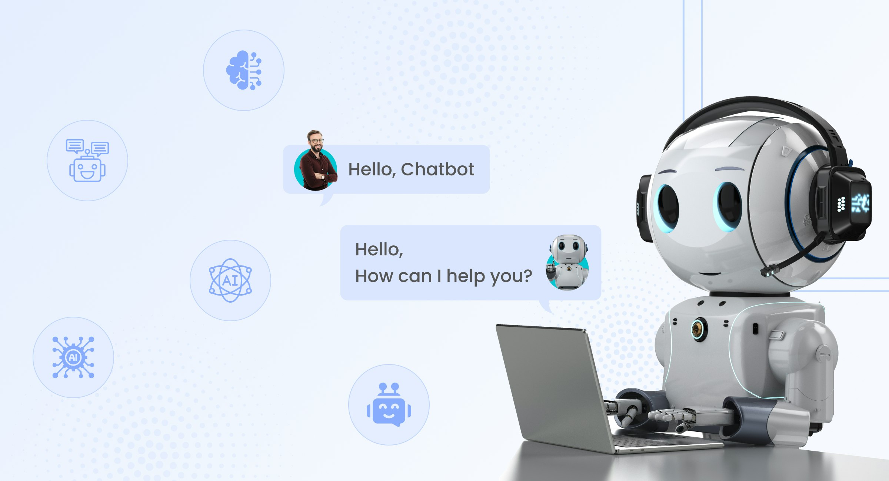
Software Solution: An AI chatbot
Queries from Alibaba
TWOTHOUSAND chatbot
In this project, my task is to train the chatbot
Answer customers
Image reference: https://www.intuz.com/blog/guide-to-building-an-ai-chatbot

Slide 4
TWOTHOUSAND Chatbot outline
Scrape and parse html from company website
Convert YouTube video to text using google voice recognition module
Pass the data to python dictionary and store the dictionary in text file
1.obtain data for custom knowledge base
Slice text document into small text document
Convert text to FAISS(Facebook AI similarity search) index and find the top 4 most relevant documents using FAISS
Pass the query, the relevant documents, and the prompt to “gpt-3.5-turbo” model
Store the chat history
2. Apply LangChain module and construct a chatbot with ChatGPT – 3.5 model

